Slide 1

IntelliConverse: A Basic NLP Solution for Real Life Problems
ASN Sr. Sec. School

Slide 2
Introducing Our Chatbot: The Simple Solution to Your Problems
Are you tired of spending hours on end trying to find the right solution to your problems? Look no further than our chatbot, the ultimate problem-solver!
Our chatbot is the simple solution to your most complex problems. With its intent-based programming and basic level NLP, it can understand and respond to your queries in a matter of seconds.

Slide 3

The Problem Statement: Why We Need a Chatbot
In today's fast-paced world, people are always looking for quick and easy solutions to their problems. This is especially true when it comes to customer service. Customers don't want to wait on hold or navigate through a complex phone tree just to get the help they need.
That's where our chatbot comes in. Our chatbot provides an instant solution to customers' problems. It can answer frequently asked questions, provide technical support, etc. With our chatbot, customers can get the help they need quickly and easily, without any hassle

Slide 4

Target Audience: Who Can Benefit from Our Chatbot
Our chatbot is designed to help anyone who needs quick and easy access to information. Whether you're a student cramming for exams or a busy professional trying to stay on top of your workload, our chatbot can provide you with the answers you need in seconds.
In addition to being a valuable resource for individuals, our chatbot can also benefit businesses and organizations. By automating routine tasks and providing instant customer support, our chatbot can save time and resources while improving overall efficiency.

Slide 5
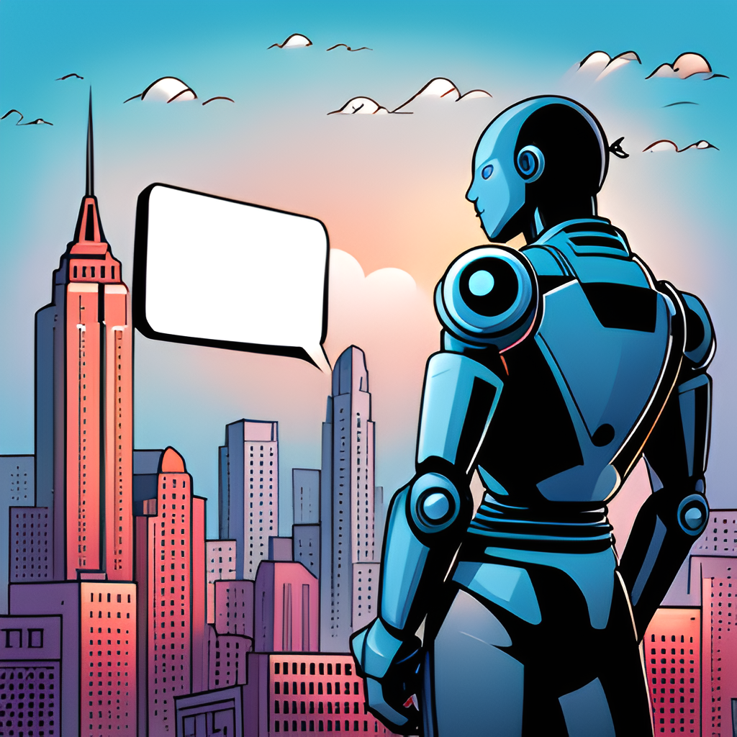
The Solution: Our Intent-Based Chatbot
Our chatbot is an intent-based solution that uses basic level NLP and Python language to provide generic answers to user queries. It is designed to be simple yet effective, making it the perfect solution for those who want quick and easy access to information.
One of the key features of our chatbot is its ability to understand user intent. This means that it can determine what a user is looking for even if they don't ask the question directly. For example, if a user asks 'What time does the movie start?', our chatbot can understand that the user is looking for movie showtimes and provide the relevant information.

Slide 6

Features: What Our Chatbot Can Do
Our chatbot is capable of providing generic answers to common questions, making it a valuable resource for anyone seeking quick and easy solutions.

Slide 7

Conclusion: The Winning Solution
In conclusion, our chatbot is the winning solution to the problem statement we presented earlier. By identifying the pain points of our target audience and providing a simple yet effective solution, we have created a tool that can help people in their daily lives or studies.
Our intent-based chatbot may be basic, but it uses only basic level NLP and Python language to provide generic answers that can benefit a wide range of users. With features such as personalized greetings and easy access to information, our chatbot is a winning solution that solves real-life problems.

Slide 8

How to use our chatbot?

Slide 9
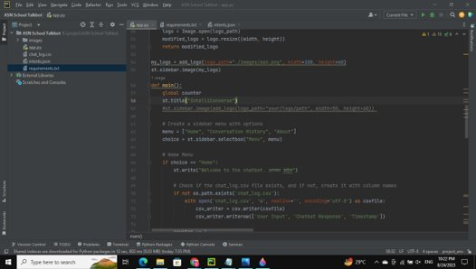
Step-1:
Open the chatbot folder in any IDE (PyCharm in this case)

Slide 10
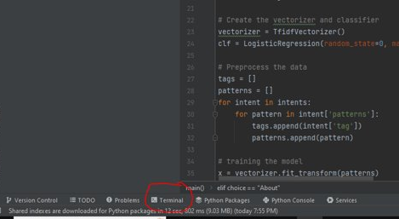
Step-2:
Click on terminal to open the local prompt.

Slide 11
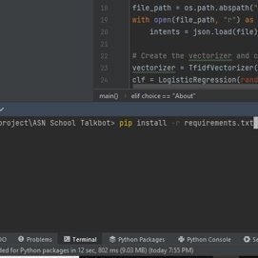
Step-3:
Type into the terminal prompt
' pip install –r requirements.txt', to install the required modules.

Slide 12
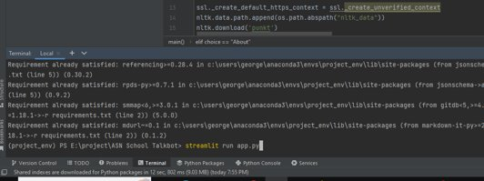
Step-4:
Now type 'streamlit run app.py' to open the chatbot.

Slide 13
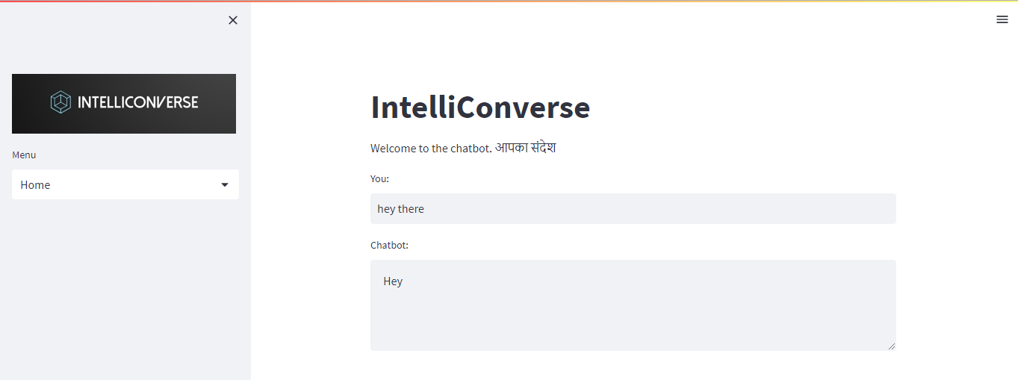
The chatbot will now open up in your default browser and is ready to use !!

Slide 14


